Slide 1
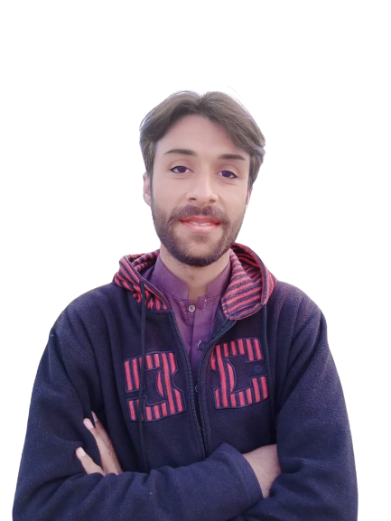
Intermediate Task Series
Problem Number 87

Slide 2
Problem Statement
Write a Desktop Python program to get two number from user to display their reminder after division.

Slide 3
Algorithm
Step1: Import a tkinter module
Step2: Create a basic window
Step3: Read two number
Step4: Divide two number
Step5: Display their reminder to user
END

Slide 4
Assignment
Write a Desktop Python program to get a string from user to change uppercase if user string is in lowercase.

